Slide 1
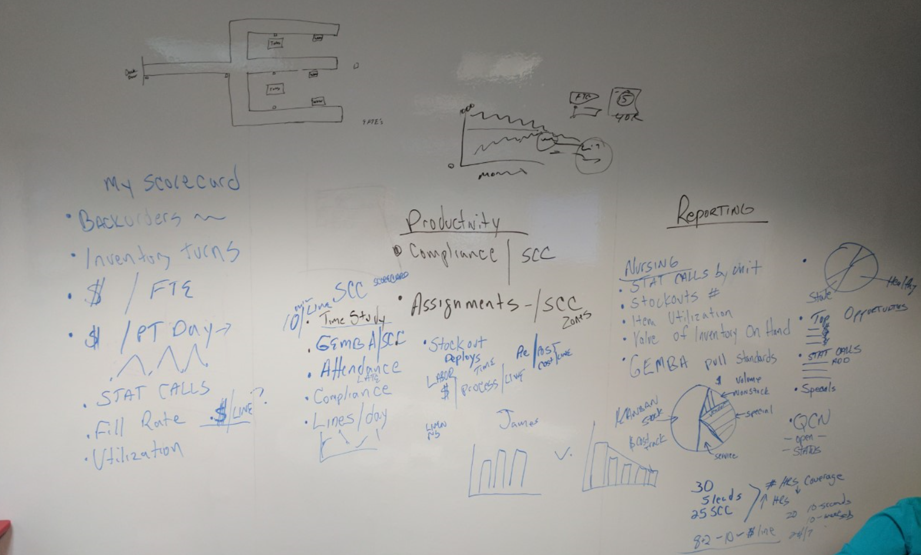
Group depts. For floor scorecarding
Feed bin seq score into strider scorecard
Strider Scorecard = Save by strider name or Zone = Time study, Bin Seq, Gemba Score (for nodes serviced), free text box to type in attendance (tardy, etc), free text box for comments, volume (lines and nodes..barchart of some sort),
Gemba Audits…why cant we slect one unit and see score over time (who did it, etc)
Warehouse details – should show what’s in excess to a years historical…a months average, etc…graphically
How do we use best in class (from all hospitals) to put ghosted (light grey) best in class data to fill-rate, stale, etc on each performance graph
Buyer messages needed for buyer scorecard
Forecast module under sourcing should have a By Item filter
“other” gemba audits - warehouse mgmt., receiving, equipt mgmt….can user “build their own”??
Clinical scorecard = Opportunities
Cones dashboard is funky - redo
QCN Dashboard – Click dept, why doesn’t run chart change?? BlueBin should build a heijunka bboard to visually show when a QCN moves from step to step.
Leadership scorecard…back orders, inv turns in perpetual, comments-free text. If upload pat volume, can we create cost per day graphs, STAT calls, Fill-rate and perct stale/utilization
How do you group cost centers (get all the scorecard data) and then it saves (in the APP) so we don’t have to recreat everytime
Direct spend by leader
Labor cost per line, look at Cost Impact Calc…same thing…total lines (dynamic), toggle #of FTE’s enter average cost per FTE…and run chart…cost per line, cost per FTE
Graphically capture clinical savings

Slide 2
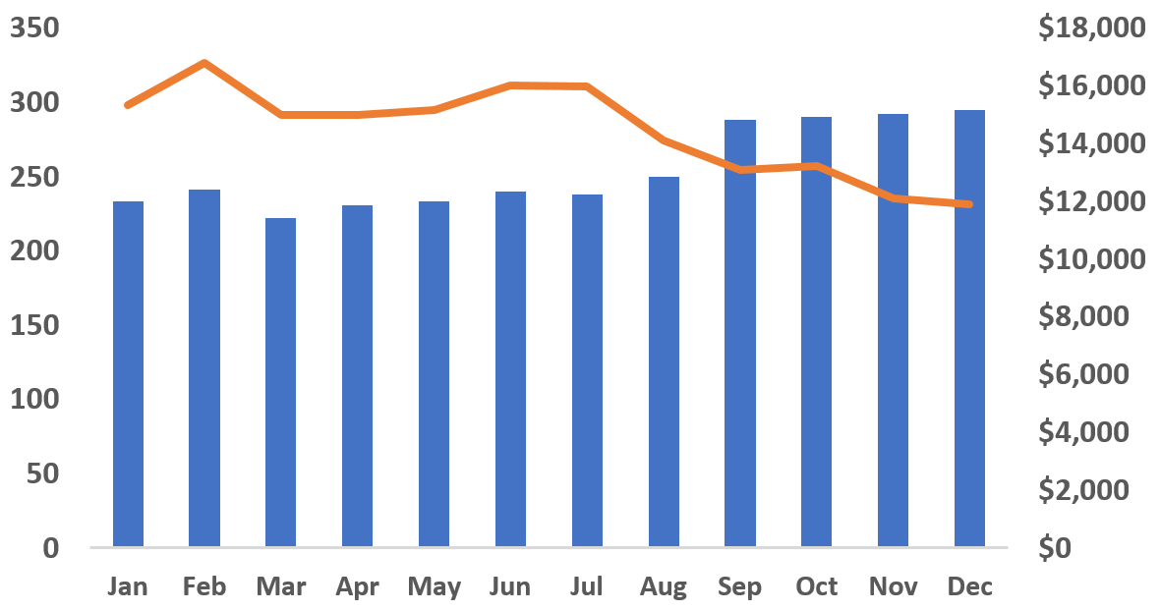
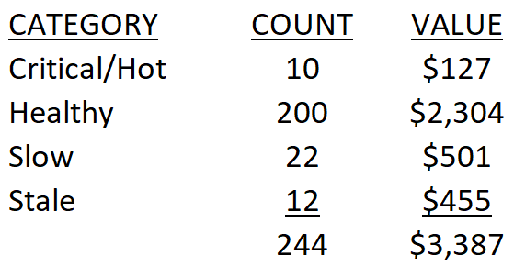
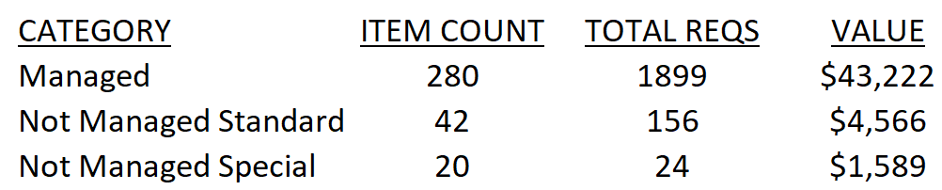
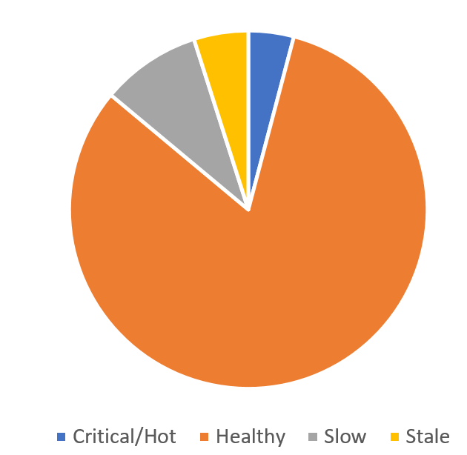
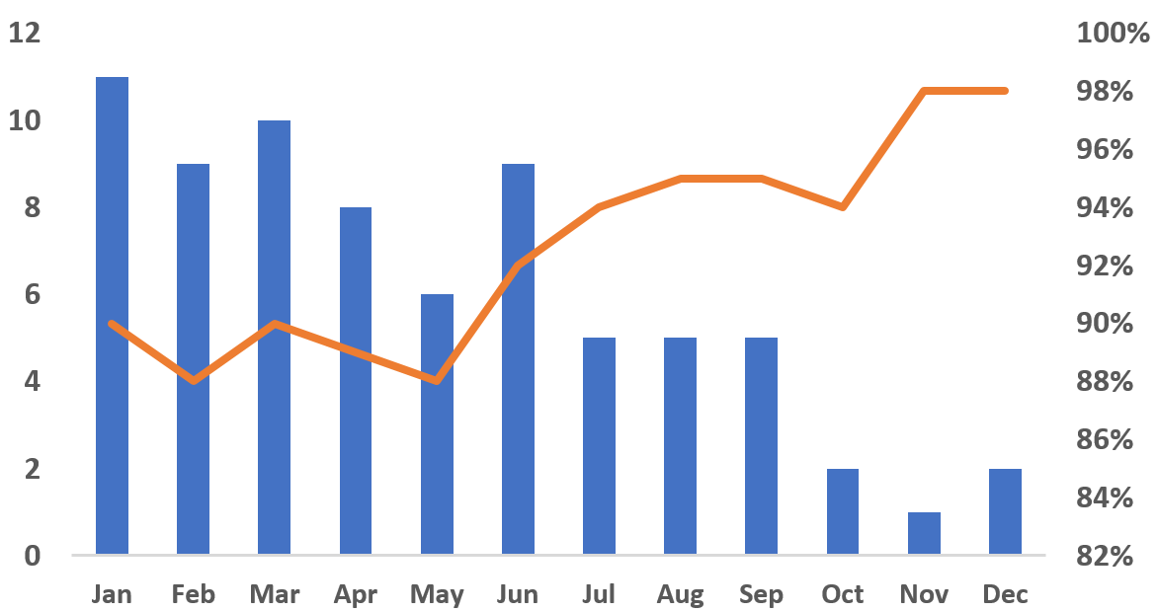
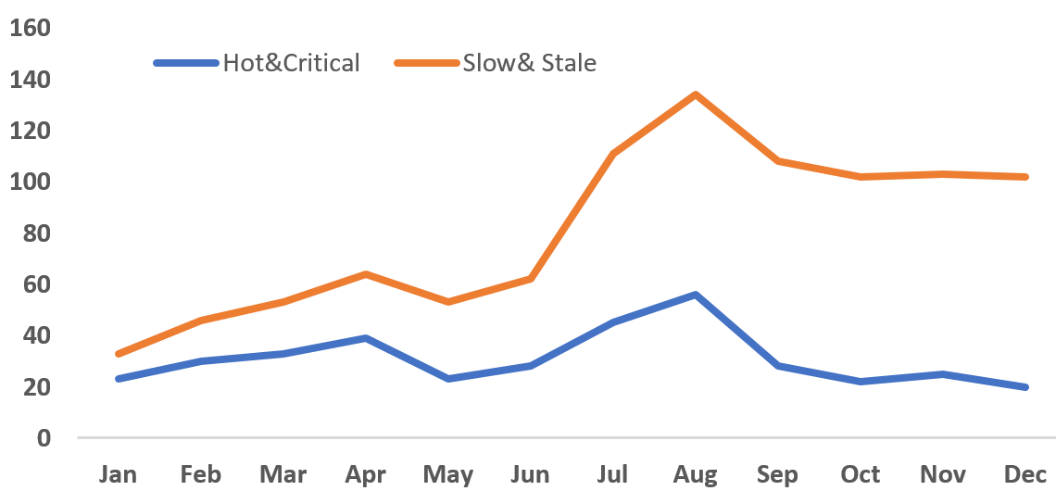
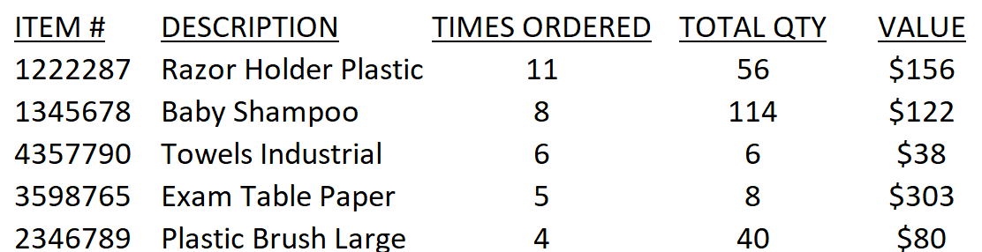
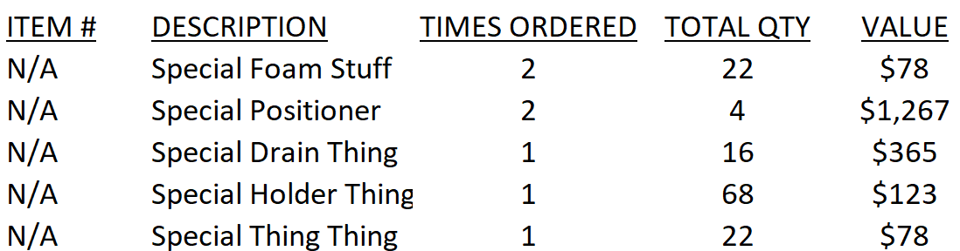
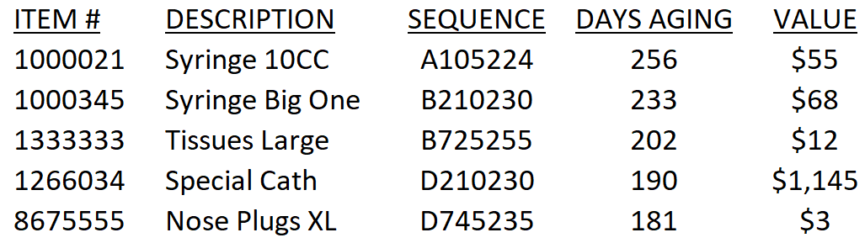
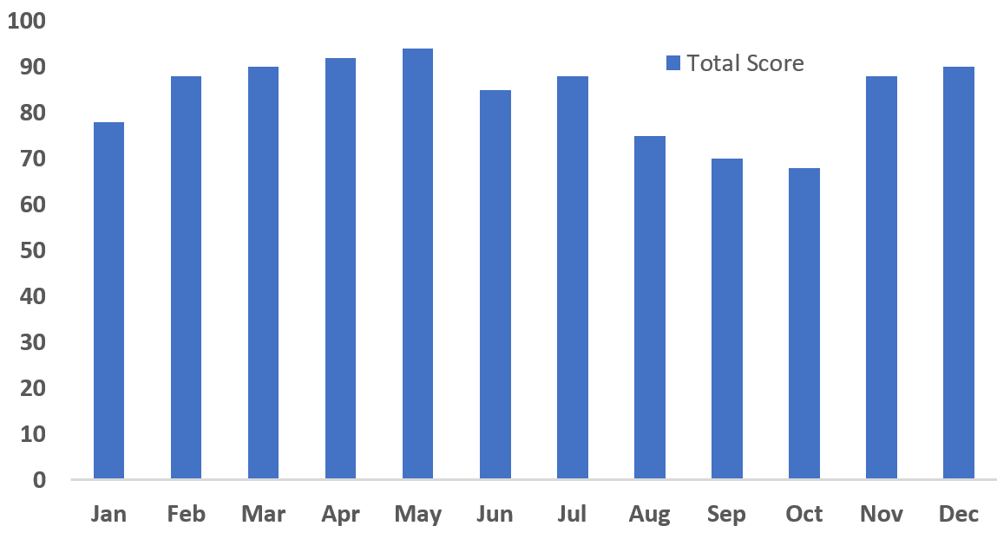
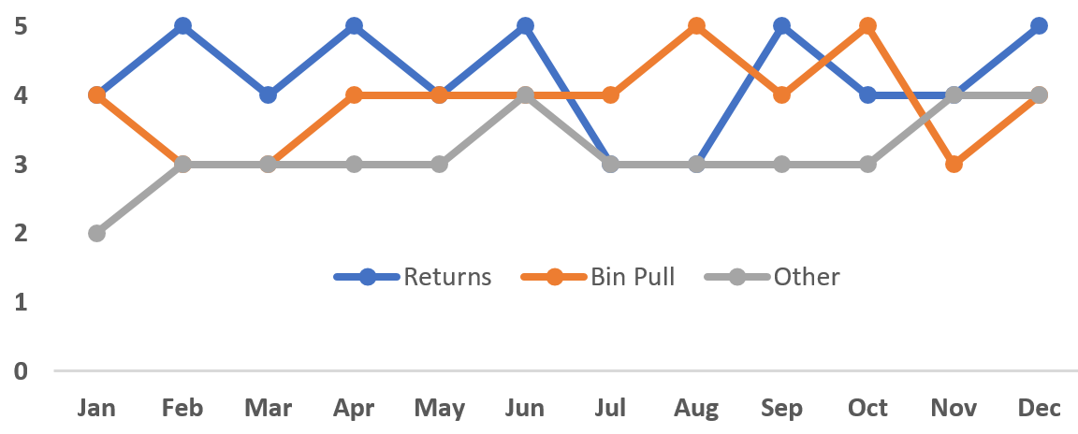
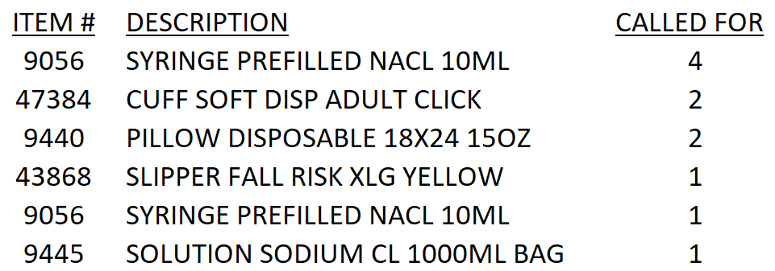
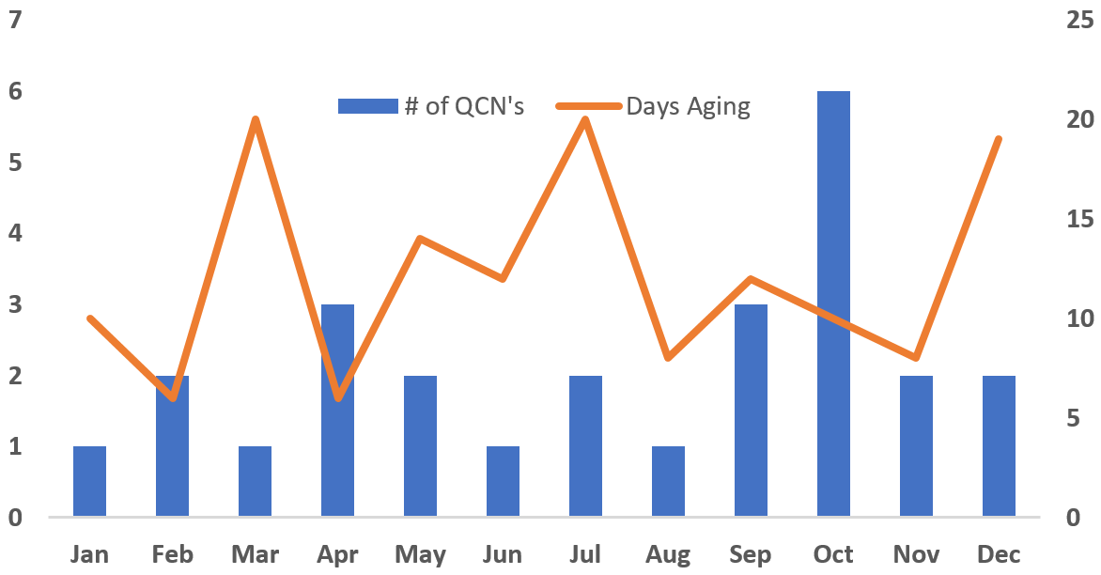
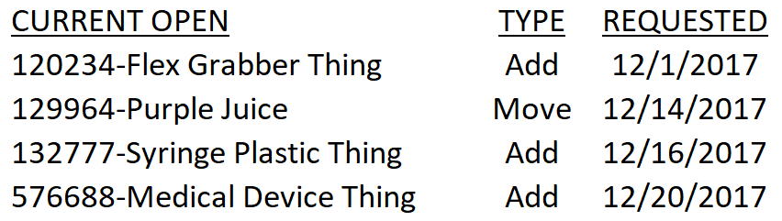
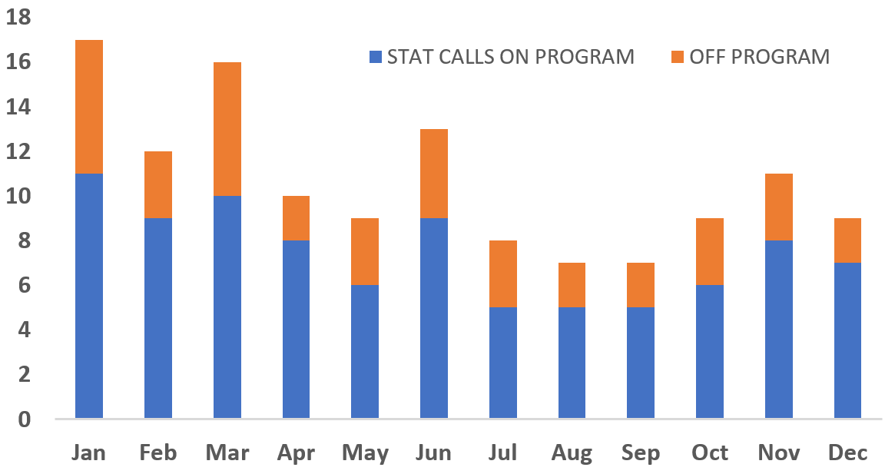
CLINICAL MANAGEMENT REPORT:
Item Count & Inv Value:
Managed Program:
Supply Standards:
Pick Facility
Pick Dept
Pick Period
Fill Rate & # of Stock-Outs:
Critical/Hot vs Slow/Stale:
Supply Standard Opportunities:
Self Managed Standard Items
Self Managed Specials Items
Stale Items & Utilization:
Stale Inv. Opportunities:
Gemba Rounding:
STAT Calls (supplies):
STAT Call Opportunities:
QCN’s:
QCN’s Open:

Slide 3
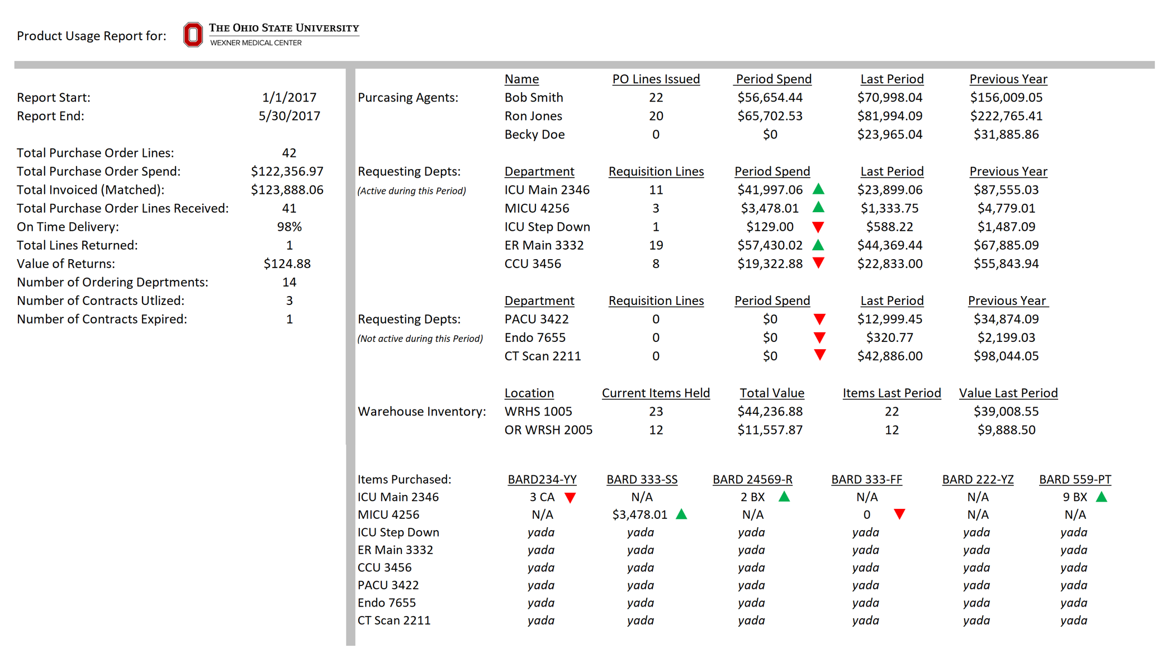
VENDOR VOLUME/SPEND REPORT

